Slide 1
“Not Only SQL” Data Storage Options for .NET
Alex Garland

Slide 2


About Me
Senior Database Developer
-> MS SQL Server, Hadoop (HDFS)
Senior Data Engineer
-> Hadoop, Hive, Impala, Spark
www.alexdgarland.com www.twitter.com/alexdgarland

Slide 3
In This Presentation…
History & Definitions – Relational vs NoSQL
Document Data Models
Scalability, “CP” & “AP” Systems
Architectures – “Polyglot Persistence”
If we have time:
Analytical Systems – Hadoop, Neo4j

Slide 4

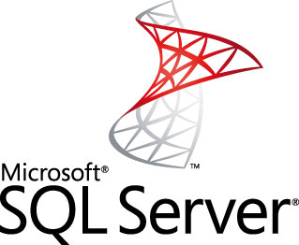


10 Years Ago
Application/“OLTP” Data Warehouse/ “OLAP”

Slide 5
Relational – The Good Parts
Flexible - Good “All-Rounder”
Strong Theoretical Basis (Maths/ Logic, ACID)
Plain-English Query Language (SQL)
Mature Technology

Slide 6
So What’s Not To Like?
Programming Model:
Object-Relational Impedance Mismatch
Schema Changes
Separation of Skill-Sets/ Expertise
Scalability
Notes:
(Audience Participation)

Slide 7
What is NOSQL?
Early 2000’s – “Web-Scale” companies
“Big Data” – 3 V’s
Volume
Velocity
Variety (Structured, Unstructured)
Tools for Massively Distributed Systems

Slide 8
Data Model - Serialization
“Across The Wire” – Binary, XML, JSON
MS SQL Server – Binary, XML
PostgreSQL – JSON
Document Databases

Slide 9
(Database Serialization Demo)

Slide 10
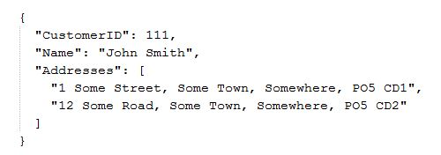
Document Databases
Extends the idea of document serialization to primary storage format
Less good at:
Protecting data integrity
Summary queries

Slide 11

(MongoDB Demo)

Slide 12


Vertical Scaling

Slide 13
Vertical Scaling
Simple – No Change to Fundamental Architecture
BUT:
Expensive – Non-Linear Cost Increases
Increasingly Specialist Hardware
No Redundancy

Slide 14
Horizontal Scaling

Slide 15
Horizontal Scaling
Linear (or better) increases in cost to scale
BUT – increased complexity of architecture/ programming model
Especially challenging for data storage

Slide 16
Horizontal Scaling – “Read-Mostly”
Master-Slave Replication
Slaves
Read Traffic
Write Traffic
Load Balancer/ App Server(s)
Write Replication
Master
Notes:
The feasibility of scaling horizontally really depends on the required workload. If we’re dealing mostly with reads, we can use what’s called master-slave replication. Basically, there is still one definitive version of the data – the master – and all writes are sent there. We then push data out (replication techniques vary…) to copies of the master – these are the slaves. These multiple servers allow us to respond to many more read requests.
The key thing to note here is that there is still only a single server for the write workload, and if anything it is doing more work than before (it also has to do some sort of work to broadcast changes to the slaves). So if we have a lot of writes, we are going to either run into the same problems with vertical scaling as before, or need to move to an alternative (probably more complex) architecture.
NB: A “write-heavy” workload doesn’t need to mean a strict majority of requests are writes, just that there are enough that this architecture of having one master, many slaves is not going to work.

Slide 17
Horizontal Scaling – “Write-Heavy”
Database Sharding
Write Traffic
Read Traffic
Data Distribution Strategy
Shard A
Shard B
Shard C
Shard D
Notes:
One of the main ways that most database systems (including relational) can be scaled up horizontally for write workloads is through sharding.
At the highest level, sharding is relatively straightforward. We store distinct parts of the data on each of several nodes. Each node handles both reads and writes, so we can handle plenty of both types of traffic.
However – the devil is in the detail – what strategy do we use to distribute the data? – making sure our application knows where to send data to and retrieve it from? How do we make sure we keep data sufficiently and evenly distributed? This can add complexity to sharding, and traditional relational databases don’t always make this easy “out of the box”.

Slide 18
CAP Theorem
Eric A. Brewer.
“Towards robust distributed systems”
Principles of Distributed Computing, Portland, Oregon, July 2000
https://www.cs.berkeley.edu/~brewer/cs262b-2004/PODC-keynote.pdf
Seth Gilbert, Nancy Lynch
“Brewer’s Conjecture and the Feasibility of Consistent, Available, Partition-Tolerant Web Services”
ACM SIGACT News Volume 33 Issue 2, June 2002
http://webpages.cs.luc.edu/~pld/353/gilbert_lynch_brewer_proof.pdf

Slide 19
CAP Theorem
We can guarantee (at most) two of:
Consistency
same data/ history on all nodes
Availability
ability to respond (fast)
Partition Tolerance
nodes/ communication may fail (non-negotiable)
blog.cloudera.com/blog/2010/04/cap-confusion-problems-with-partition-tolerance

Slide 20
CAP – A Simple Example
Network partition
a = 1
UPDATE: a = 3
a = 1
a = 1
a = 1
a = 1
UPDATE: a = 2

Slide 21
“CP” Systems
Relational Databases
MongoDB
CP with built-in sharding, replica sets
Although:
https://aphyr.com/posts/284-call-me-maybe-mongodb
https://aphyr.com/posts/322-call-me-maybe-mongodb-stale-reads
etc. …

Slide 22
“AP” Systems – Riak & Cassandra
Highly optimised for availability
Based on Amazon “Dynamo” paper
“Ring Model” for data distribution
No privileged/ “primary” nodes
“Eventual” Consistency, Tunable Consistency
Key-based “Aggregate” data models (as per document DBs) – no joins!

Slide 23
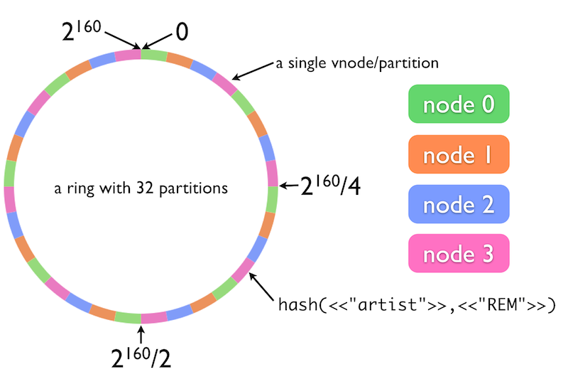
The Ring Model
http://docs.basho.com/riak/latest/theory/concepts/
Notes:
This is a model for data and load distribution that is shared by Riak and Cassandra (diagram is from Basho (Riak) website – but same principle), and has a deep impact on how they store, manage and retrieve data.

Slide 24


Riak
Distributed Key-Value Store
Value = Any Binary Data
Open-Source
Developed/ Supported by Basho
Linux/ Erlang

Slide 25
(Riak Demo)

Slide 26


Apache Cassandra
AP Store for Structured (Column-Family) Data
Supported by DataStax
Free training - www.datastax.com/what-we-offer/products-services/training
Cassandra Query Language
Thrift RPC -> CQL1 -> CQL2 -> CQL3
Model (superficially) similar to relational

Slide 27
(Cassandra Demo)

Slide 28
Cassandra Data Modelling
www.youtube.com/user/PlanetCassandra/search?query=model
Tables – But No Joins
Write Multiple Copies/ Views of Data
Row Storage Model(s)

Slide 29
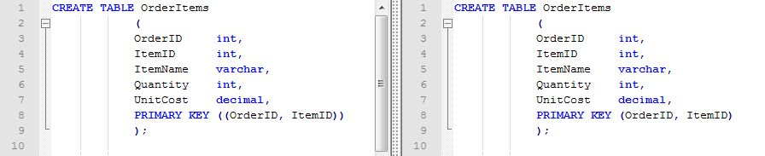
Cassandra Row Storage
Spot The Difference:

Slide 30

Cassandra Row Storage
Composite Row (Partition) Key
PRIMARY KEY ((OrderID, ItemID))
“Wide Rows” PRIMARY KEY (OrderID, ItemID)

Slide 31


Cloud Hosting
Amazon Web Services
Relational Database Service
Oracle/ MS SQL / MySQL/ Postgres/ Aurora, Read-Scaling
NoSQL
DynamoDB (Document/ Key-Value)
EC2 Hosting – MongoDB, Couchbase, other …
Google Cloud Platform
“Cloud SQL” (MySQL)
Cloud DataStore, BigQuery, DataFlow etc.

Slide 32

Cloud Hosting – MS Azure
Relational
NoSQL
DataStax Cassandra
Redis Cache
MongoLab
DocumentDB
Analytics
Hadoop – HDInsight, Cloudera
Machine Learning Services

Slide 33
DocumentDB (MS Azure)
Proprietary Microsoft NoSQL DB
JSON document format
Tunable Consistency
Caveats:
In preview
Vendor lock-in

Slide 34
(DocumentDB Demo)

Slide 35
Mixed Architectures
“Polyglot Persistence”
martinfowler.com/bliki/PolyglotPersistence.html
Different Business Processes
Read-Write Split -> Reporting

Slide 36
Business Processes (Amazon)
“For the checkout process you always want to honor requests to add items to a shopping cart because it's revenue producing. In this case you choose high availability. Errors are hidden from the customer and sorted out later.”
“When a customer submits an order you favor consistency because several services--credit card processing, shipping and handling, reporting--are simultaneously accessing the data.”
highscalability.com/amazon-architecture

Slide 37
Reporting Systems
Old-World – OLTP vs OLAP – Relational
New-World :
Separate Analytics (Hadoop, etc.)
Integrate with (e.g.) Cassandra
Streaming Analytics
Lambda Architecture

Slide 38
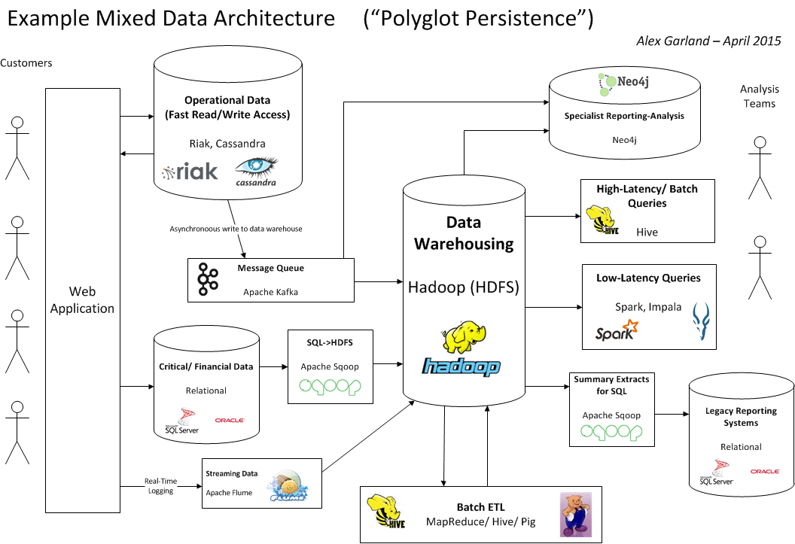

Slide 39




Hadoop
Basis - GFS, MapReduce etc.
Yahoo! – Doug Cutting
Apache Top-Level Project
“Big” Data-Warehousing (++)

Slide 40
Distributed File System (HDFS)
Distributed, CP, Append-Only FileSystem
High-Latency Access/ ETL via Java MapReduce
vs. -> HBase
Basis for other analysis/ query tools

Slide 41
Hadoop – Core Tools
Local File System
Hive
Pig
(Java API)
Map
Reduce
PUT
GET
HDFS
Hadoop Distributed File System

Slide 42
MapReduce
Method of aggregating data from multiple nodes
“Send the work to the data”
Also implemented in Riak, MongoDB (etc.)

Slide 43
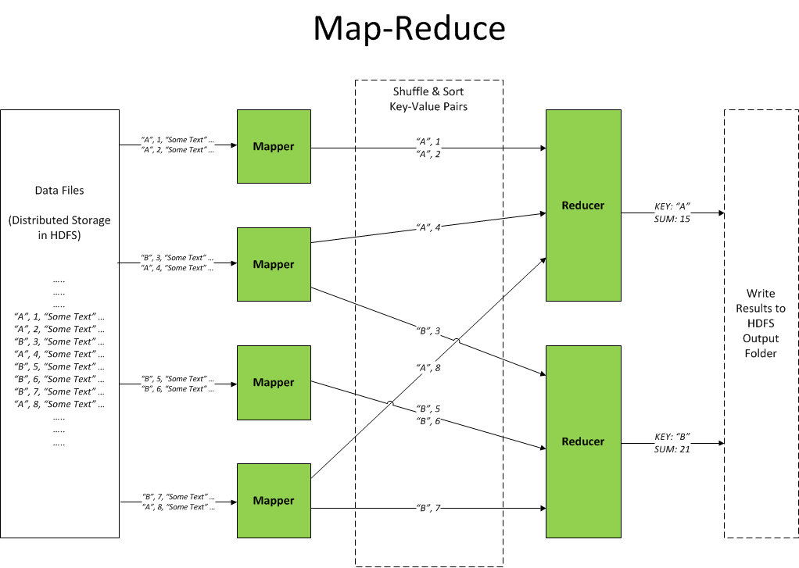

Slide 44
(Hadoop MapReduce Demo)

Slide 45


Hadoop Ecosystem
“Linux for Distributed Systems”
– HDFS, MapReduce, YARN
Related tools:
Hive, Pig, Spark, Impala, Mahout, Giraph, HBase, Cassandra, ZooKeeper, Ambari, Flume, Sqoop … (etc.) …
HortonWorks, Cloudera
3rd Party – e.g. HDInsight, SAS Visual Analytics

Slide 46

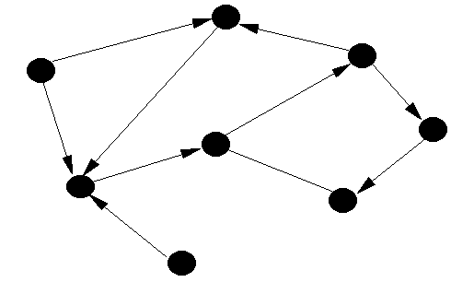
Graph Databases
Based on Graph Theory (Euler et al.)
Not relational – but not “standard” NoSQL

Slide 47

Neo4j
Easy to install, use
Expressive, flexible data model for related data
Use cases (YouTube playlist) - goo.gl/RrdQjp
ACID semantics, scalability limits as relational
More from me - http://alexdgarland.com/category/neo4j

Slide 48
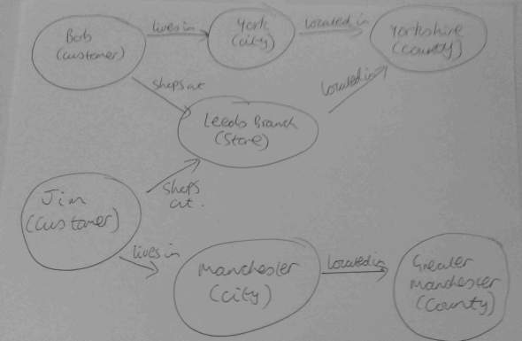
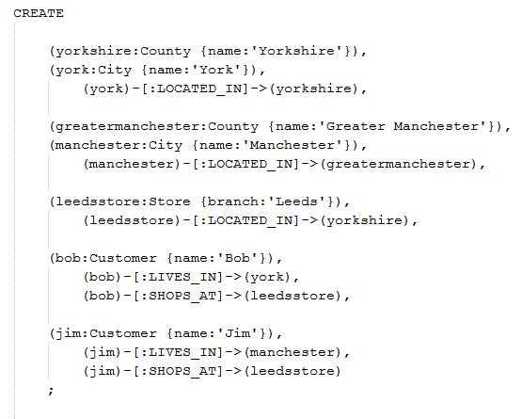
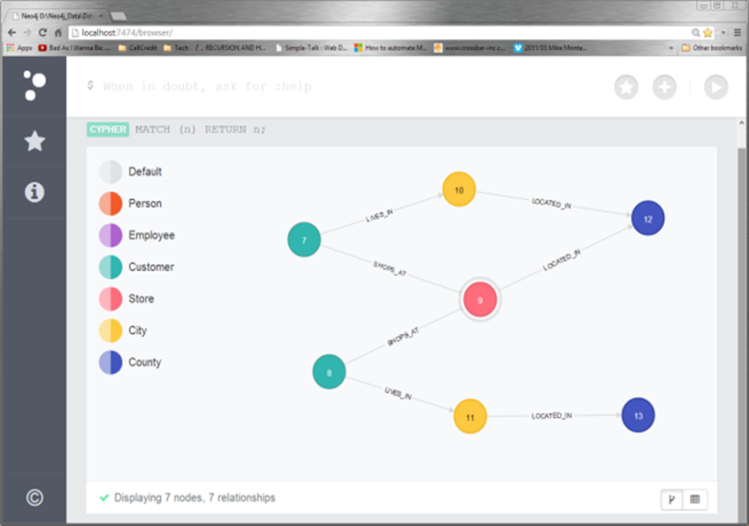
Neo4j – Data Model Design

Slide 49
Neo4j - Demo
Sketch -> Code -> Model
Client access (Neo4jClient)

